Slide 1


Suicide Rate
Feb 2022
Group 8
Alice Guimarães
Alvin Tong
Maria Ahmed
Michael Walter
Zeinab Bahsoun
Yash Berawala

Slide 2

Agenda
01 Chapter/ Introduction
02 Chapter/ Reasons
03 Chapter/ Questions
04 Chapter/ Data description
05 Chapter/ Data Exploratory
06 Chapter/ Technologies
07 Chapter/ ERD & Database
08 Chapter/ Machine Learning Model
09 Chapter/ Dashboard
10 Chapter/ Prevention Plan
11 Chapter/ Conclusion
|
Group 8

Slide 3
Introduction
Suicide is a serious global public health issue not limited to one single factor, our project will be focusing on which factors have the highest impact on the suicide rates
more
it accounts
700 000
1.3%
people die by suicide every year (WHO)
of death worldwide
|
Group 8

Slide 4
Reasons
Suicide Factors
Prevention
Impacts of Time
Understanding the relationship between suicide rates and different demographic, socio-economics and health factors can help identify potential individuals at risk and increased suicide.
With the increasing suicide rates in recent years, the need for increased awareness, education, and resources to address this issue is getting highlighted.
Understanding how the factors that impact suicide rates change over time and across countries.
|
Group 8

Slide 5

Is there a correlation between suicide risk and socio-economic status and/or health data?
What are the most significant factors that impact suicide rate?
Which machine learning model has a better accuracy for predicting suicide rate?
| Group 8

Slide 6






Technologies
|
Group 8

Slide 7
Data Clean Process
1
2
3
4
5
6
Data Type
Filter Columns
Pivot Table
Null Values
Merge Datasets
Remove Columns
convert the 'Time' column to string to create an unique identifier column 'LocationTime'
'Flag Codes', 'Measure', 'Indicator' and 'Frequency' because it did not have any relevant data for the prediction
filter by the 'Time' column to include values between 1990 and 2020
create a separate column for each 'subject' group
handle all the null values doing the average for it
merged all the 8 tables to a single dataset by the 'LocationTime' column.
|
Group 8

Slide 8
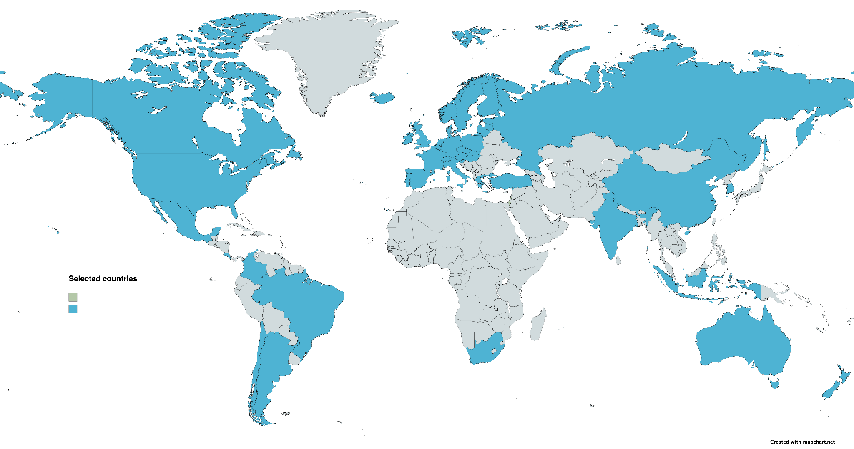
Data
Description
Countries
Argentina, Australia, Austria, Belgium, Brazil, Canada, Chile, China, Colombia, Costa Rica, Czech Republic, Denmark, Estonia, Finland, France, Germany, Greece, Hungary, Iceland, India, Indonesia, Ireland, Israel, Italy, South Korea, Latvia, Lithuania, Luxembourg, Mexico, Netherlands, New Zealand, Norway, Poland, Portugal, Russia, Slovak Republic, Slovenia, South Africa, Spain, Sweden, Switzerland, Türkiye, United Kingdom, United States
|
Group 8

Slide 9
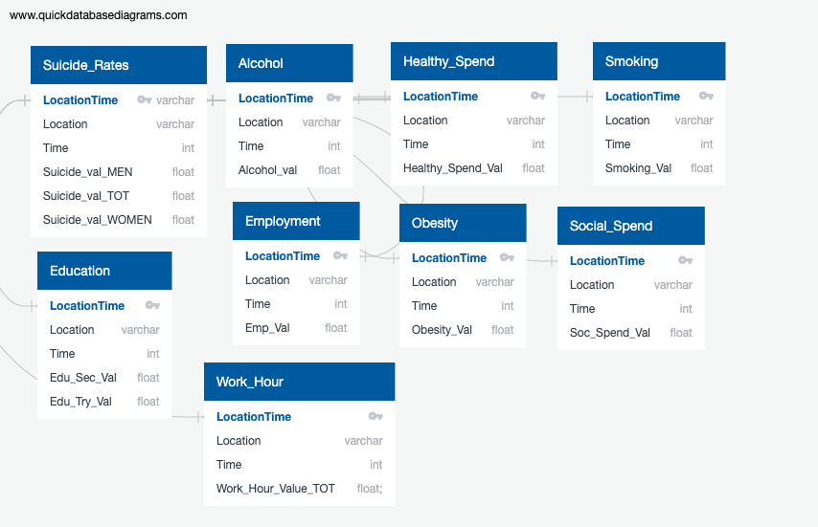
ERD & Database
|
Group 8

Slide 10
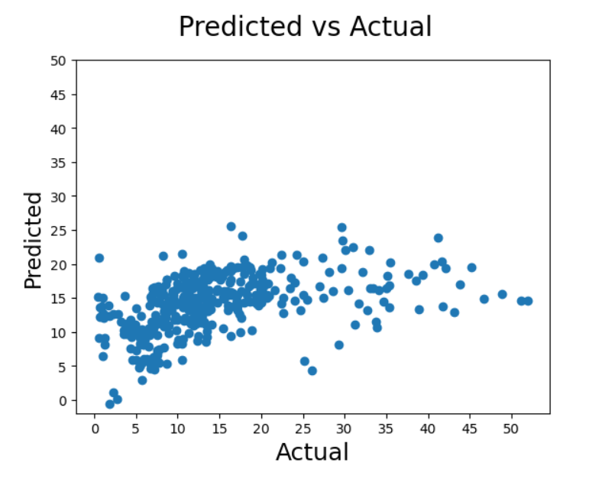
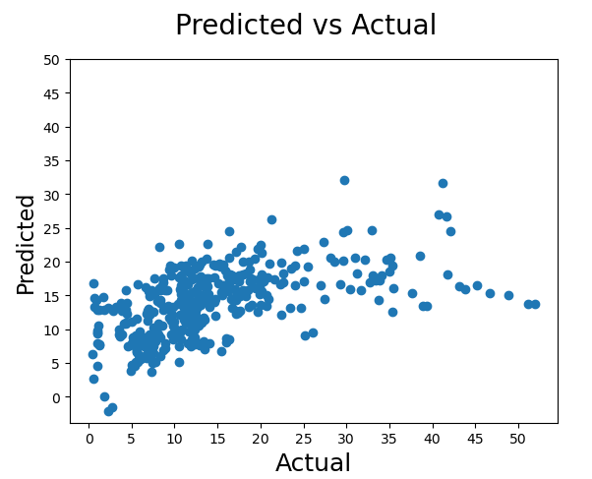
Machine Learning - Multilinear Regression
With Null values set to Zero
With Null values set to average
|
Group 8

Slide 11
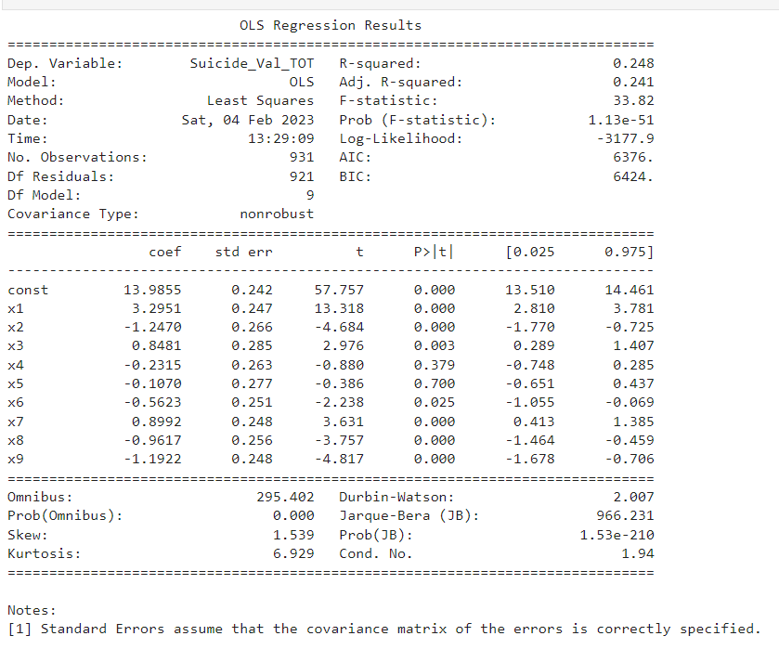
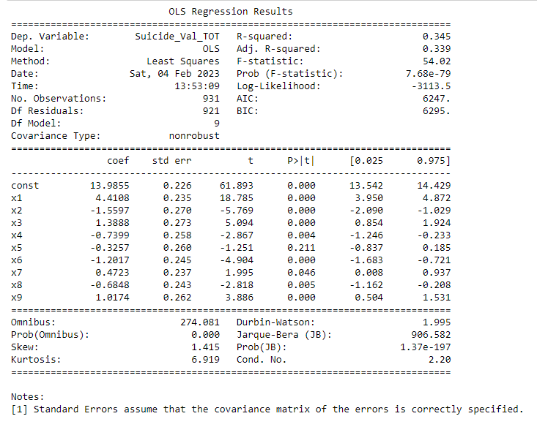
Machine Learning- Multilinear Regression
|
With Null values set to Zero
Group 8
With Null values set to average
Notes:
Multilinear regression is a model that estimates the relationship between a quantitative dependent variable and two ore more independent variables using a straight line. In our study, the rate of suicide by country and year was the dependent variable and being able to identify which factors impact suicide were the independent variable. One of the limitations with Multilinear regression is that when you have multiple variables, you have the risk of having two or more independent variables that are highly correlated to one another.

Slide 12
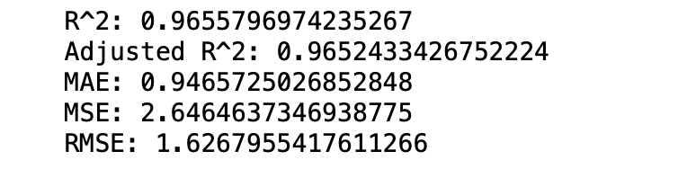
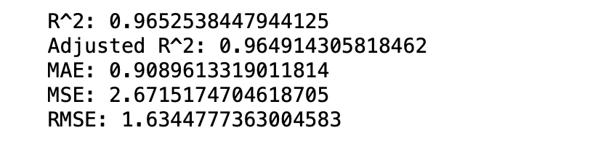
Machine Learning- Random Forest Regressor
With Null values set to Zero
With Null values set to average
|
Group 8
Notes:
Multilinear regression is a model that estimates the relationship between a quantitative dependent variable and two ore more independent variables using a straight line. In our study, the rate of suicide by country and year was the dependent variable and being able to identify which factors impact suicide were the independent variable. One of the limitations with Multilinear regression is that when you have multiple variables, you have the risk of having two or more independent variables that are highly correlated to one another.

Slide 13
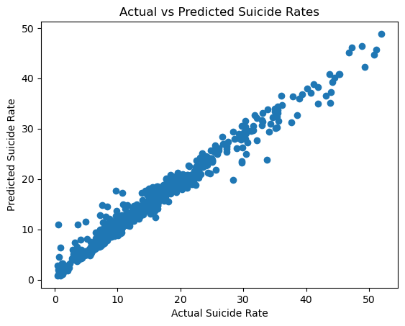
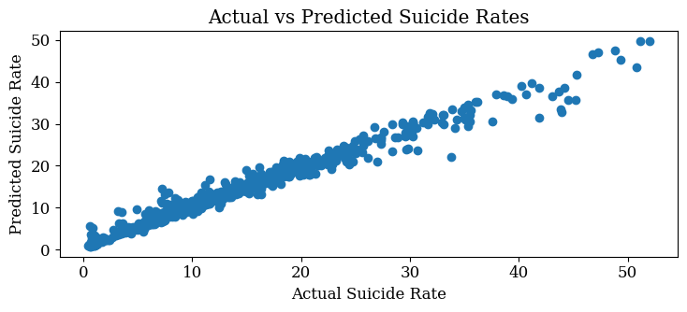
Machine Learning - Random Forest Regressor
|
With Null values set to Zero
Group 8
With Null values set to average

Slide 14
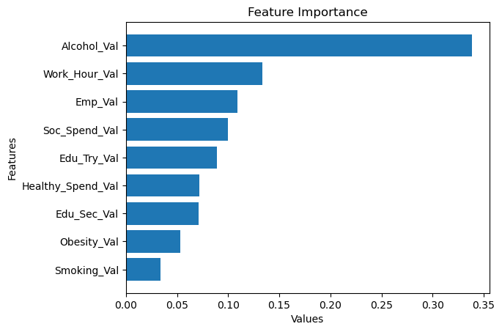
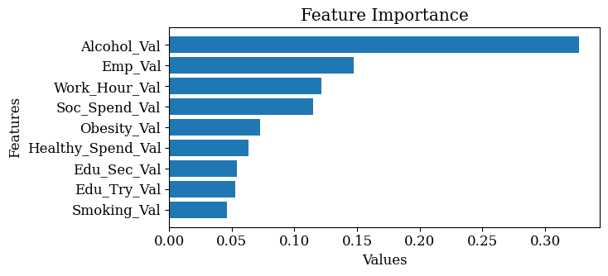
Machine Learning - Random Forest Regressor
With Null values set to Zero
With Null values set to average
|
Group 8

Slide 15
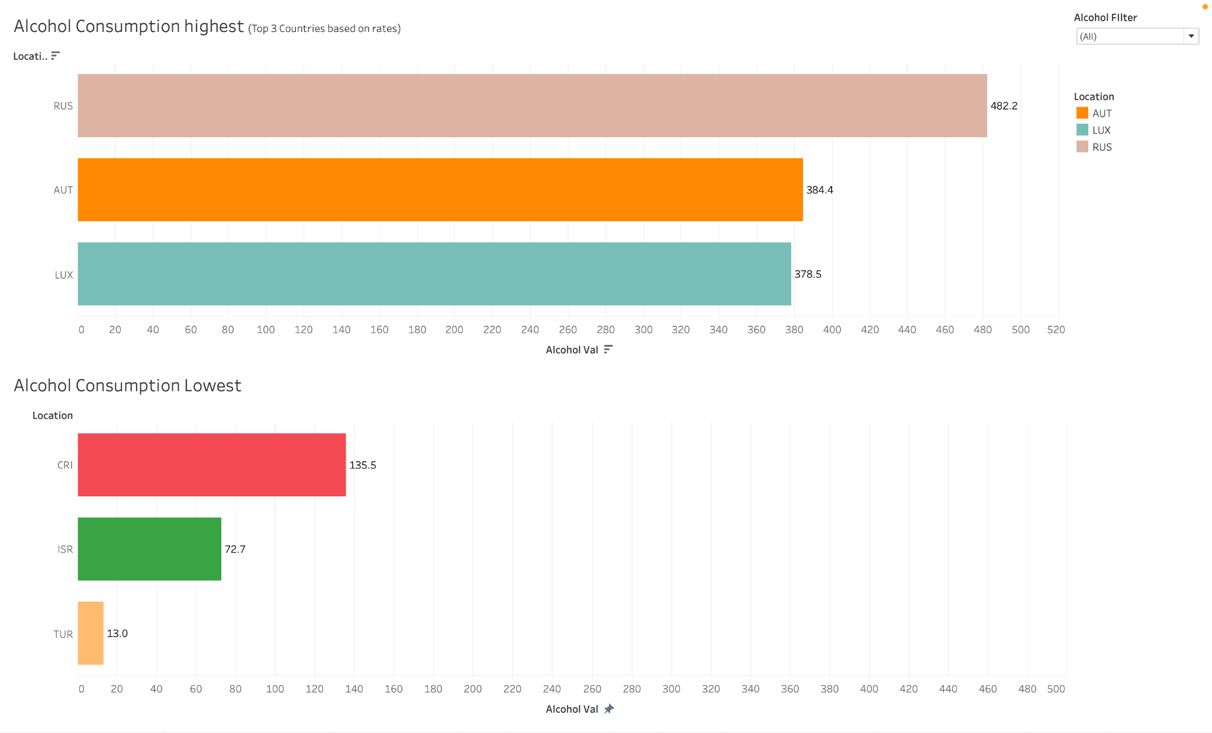
Dashboard
Alcohol Consumption
|
Group 8
Notes:
Machine learning has been used to analyze data and identify potential factors that contribute to suicide. The findings suggest that alcohol consumption and working long hours are considered to be among the highest factors that can increase the risk of suicide. When it comes to alcohol consumption we found Russia, Austria, and Luxembourg have the highest consumption while Croatia, Israel, and Turkey have the lowest consumption.

Slide 16
Is there a correlation between suicide risk and socio-economic status and/or health data?
What are the most significant factors that impact suicide rate?
Which machine learning model has a better accuracy for predicting suicide rate?
| Group 8

Slide 17

Prevention Plan
Alcohol Consumption
Increase taxes
Restricting availability of alcohol
Providing education and social support
Restrictions on alcohol advertisement
|
Group 8

Slide 18
Prevention Plan
Work Hour
Foster positive relationships
Open conversation environment
Flexible working hours
|
Group 8

Slide 19

Key Suicide Points
In our model, Lithuania presented the highest risk of suicide out of the countries we looked at
Alcohol showed to have a strong correlation with suicide rates
Men had higher suicide numbers compared to women
One factor cannot determine the impact suicide has on communities

Slide 20

Conclusion
During this project our group realized suicide is a complex issue that is not easily remedied by fixing a handful of factors. Suicide is a multifaceted problem that requires more attention in order to work towards solutions.
Weather data
Mental health
Immigration status
Cultural views
|
Group 8

Slide 21
References
Adult education level. OECD (2023). Retrieved January 23, 2023, from https://data.oecd.org/eduatt/adult-education-level.htm
Alcohol Consumption. OECD (2023). Retrieved January 23, 2023, from https://data.oecd.org/healthrisk/alcohol-consumption.htm
Employment Rate. OECD (2023). Retrieved January 23, 2023, from https://data.oecd.org/emp/employment-rate.htm
Daily Smokers. OECD (2023). Retrieved January 23, 2023, from https://data.oecd.org/healthrisk/daily-smokers.htm#indicator-chart
Overweight or obese population. OECD (2023). Retrieved January 23, 2023, from https://data.oecd.org/healthrisk/overweight-or-obese-population.htm#indicator-chart
Health Spending. OECD (2023). Retrieved January 23, 2023, from https://data.oecd.org/healthres/health-spending.htm
Social Spending. OECD (2023). Retrieved January 23, 2023, from https://data.oecd.org/socialexp/social-spending.htm.
Suicide Rates. OECD (2023). Retrieved January 23, 2023, from https://data.oecd.org/healthstat/suicide-rates.htm.
Suicide statistics. American Foundation for Suicide Prevention (2023). Retrieved January 27, 2023, from https://afsp.org/suicide-statistics/
Suicide. World Health Organization (2021). Retrieved January 27, 2023, from https://www.who.int/news-room/fact-sheets/detail/suicide
Mental health at work. World Health Organization (2022). Retrieved February 4, 2023, from https://www.who.int/news-room/fact-sheets/detail/mental-health-at-work#:~:text=They%20may%20include%20giving%20individual,regular%20supportive%20meetings%20with%20supervisors.
Community Strategies to Reduce Excessive Alcohol Use. Centers for Disease Control and Prevention (2022). Retrieved February 4, 2023, from https://www.cdc.gov/cancer/alcohol/reducing-excessive-alcohol-use/community-strategies.htm
Reducing harm due to alcohol: success stories from 3 countries. World Health Organization (2021). Retrieved February 4, 2023, from https://www.who.int/europe/news/item/15-04-2021-reducing-harm-due-to-alcohol-success-stories-from-3-countries
|
Group 8

